Slide 1
Hopfield Model
Neural networks – Assignment 03
By: Nadav Porat
Date: 10/5/20

Slide 2
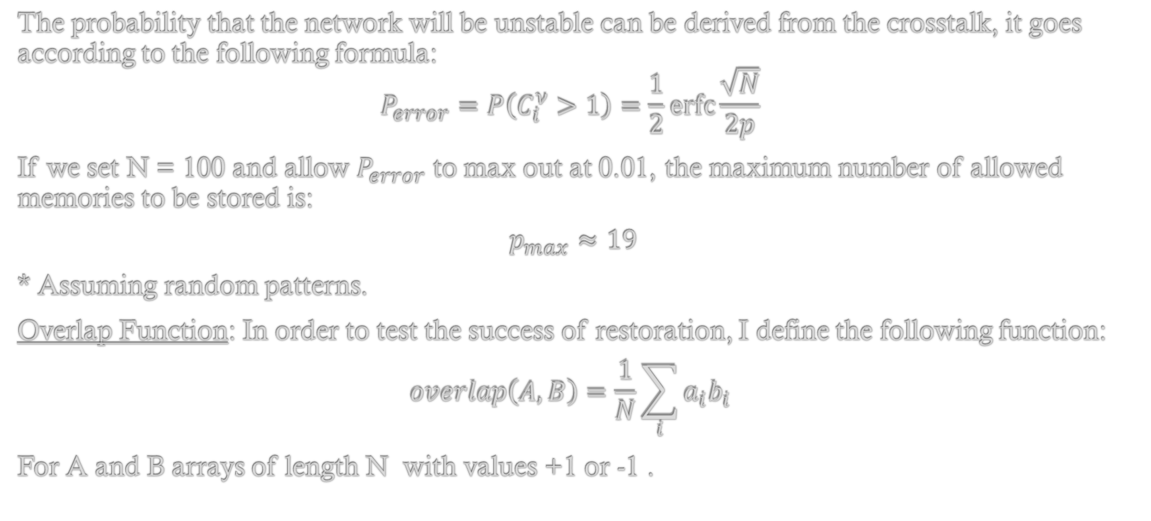
Number of memories and Overlap
Test Network – 100 Cells
The probability that the network will be unstable can be derived from the crosstalk, it goes according to the following formula:
$$P_{error}=P\left(C_{i}^{ν}>1\right)=\frac{1}{2}\operatorname{erfc}{\frac{\sqrt{N}}{2p} }$$
If we set N = 100 and allow $P_{error}$ to max out at 0.01, the maximum number of allowed memories to be stored is:
$$p_{max}≈19$$
* Assuming random patterns.
Overlap Function: In order to test the success of restoration, I define the following function:
$$overlap\left(A,B\right)=\frac{1}{N}\sum_{i}{a_{i}b_{i}}$$
For A and B arrays of length N with values +1 or -1 .

Slide 3
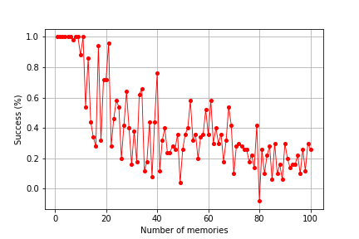
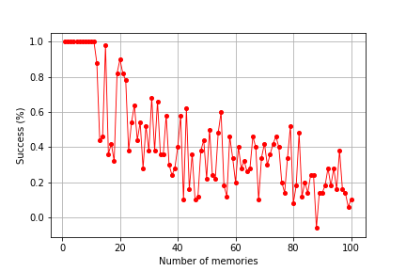
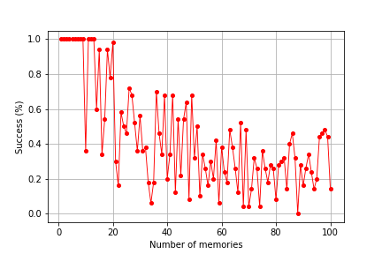
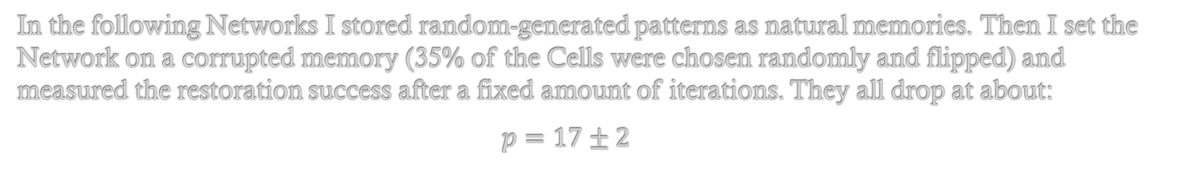
Success vs Number of memories
Test Network – 100 Cells
In the following Networks I stored random-generated patterns as natural memories. Then I set the Network on a corrupted memory (35% of the Cells were chosen randomly and flipped) and measured the restoration success after a fixed amount of iterations. They all drop at about:
$p=17±2$

Slide 4
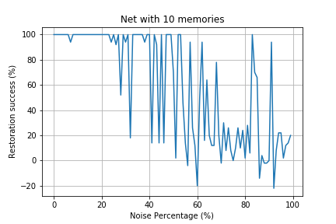
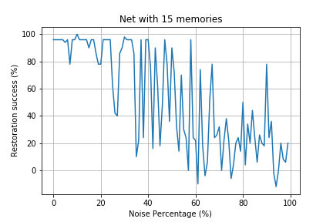
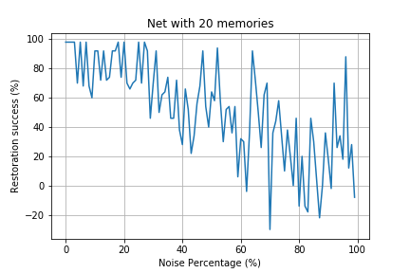
Success vs Noise
Test Network – 100 Cells
In the following graphs, I inserted 10, 15, and 20 random memory patterns into the Network. Then chose one memory at random and corrupted it by adding varying degrees of noise. Then I measured the restoration success after a fixed amount of iterations.
We can clearly see that the restoration success drops as the noise increases. Also, the fewer the memories, the better the system can deal with noise, and the Network seems stable for small amounts of noise.

Slide 5
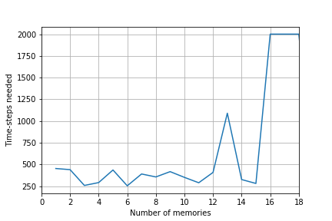
Time vs Number of memories
Test Network – 100 Cells
In the same network, the time-steps needed to restore a corrupted pattern grows as a function of the number of memories. The usual time-steps can be estimated around ~350.
* In the graph, 2000 time-steps is the limit of measurement.

Slide 6
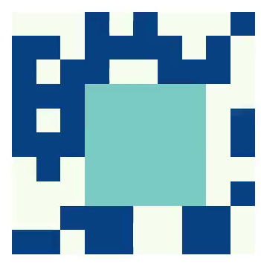
Deterministic distortion
Test Network – 100 Cells
I took one random pattern from the system and corrupted it deterministically. Meaning I changed a 4 by 4 square in the middle and set it as the initial state of the Net. The system’s response:
*Light blue – Cells with wrong values.
*Dark blue – Cells with correct values

Slide 7
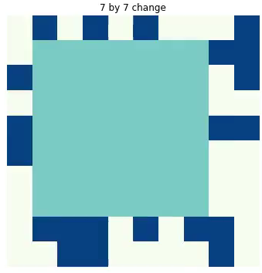
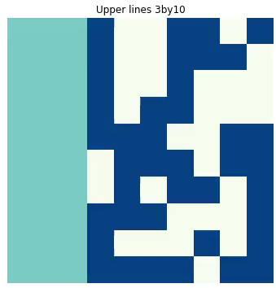
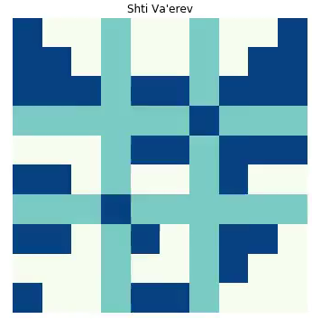
Deterministic distortion
Test Network – 100 Cells
More cool Vids:
I can conclude that deterministic change has no meaning (with random patterns), only the amount of noise has meaning.

Slide 8
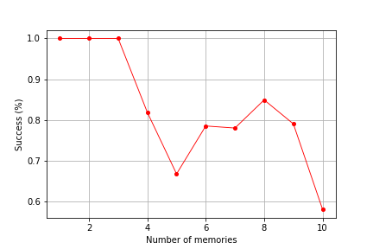
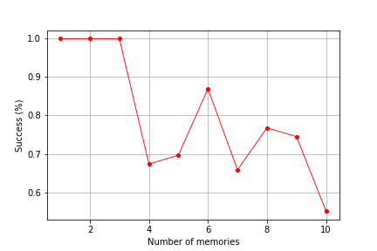
MNIST Network
MNIST Network
The MNIST Network behaves vastly different. Because of high correlation between pixel representation of decimal digits, the Network is barley stable with more than ~2 memories stored in (corruptness is at 20%).

Slide 9

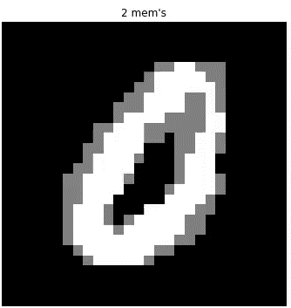
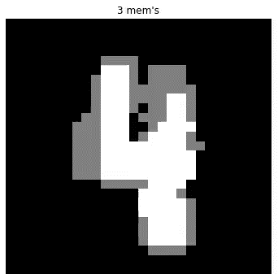
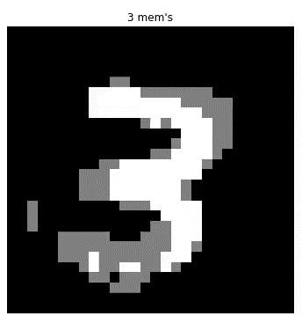
Retrieving a digit from a different pattern
MNIST Network
Using the MNIST database, I inserted a few random digits into the system. Then I set the Network on a different pattern corresponding to the digits it has memorized. Since the MNIST Network is barley stable with less than 3 memories, I tested it with 2-3 memories stored.
The results are dependent on how similar the digit patterns are, and the amount of memories.
2 mem’s

Slide 10





Shifted digit patterns
Digits Network
Since the MNIST Network preformed poorly with more than three memories, I used a different set of digits in order to continue testing. The digits I used are bigger (32*32) and sharper, therefore provide better results:
* These photos and the function that implements them are taken from this guy “duskybomb” on GitHub.

Slide 11
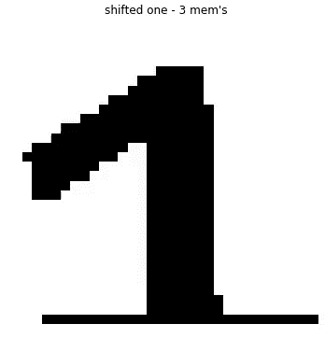


Shifted digit patterns
Digits Network
We can see that as I increase the memories stored in the Network, the restoration success drop.
It is worth to note that both randomly corrupting a digit and shifting it increase its Hamming distance from the original digit. But shifting can also decrease the Hamming distance to another digit. So shifting can be worse than randomly corrupting.

